Slide 1

Lecture 0
Programming Basics

Slide 2

Agenda
Programming Paradigm
Types of Programming

Slide 3
Programming Paradigm

Slide 4
Programming Paradigm
Input
Process
Output

Slide 5
Programming Paradigm
Input
Process
Output
Human Input
  Touch screen
  Mouse, keyboard
  Microphone
  Camera
Programmatic Input
  Call from webpage to server
  Call from one system to another system
  Call from one module to another module

Slide 6
Programming Paradigm
Input
Process
Output
Apps
Server side programs
Database
Webpages
Electronic Circuit

Slide 7
Programming Paradigm
Input
Process
Output
Apps
Server side programs
Database
Webpages
Electronic Circuit
Our Focus!!!

Slide 8
Programming Paradigm
Input
Process
Output
Webpages
Gaming Scene
Animations, Video
Sound
File (.jpg, .png etc)

Slide 9
Types of Programming

Slide 10
Types of Program
(in the sense of execution ordering)
Sequential
Programming
Object Oriented Programming
Event Driven Programming

Slide 11
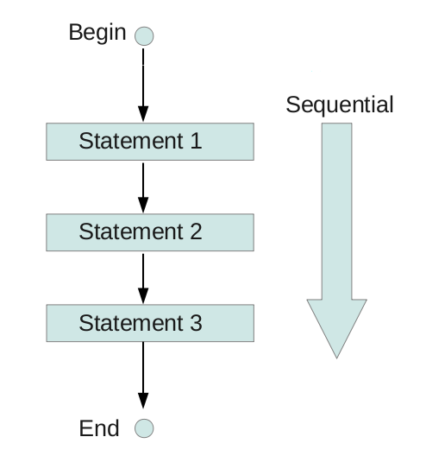
Sequential Programming
Sequential
Programming
Step-by-Step, Linear
Only go with 1 direction until the end of the code
Example (How to cook an egg)
Whisk 2 eggs
Heat a pan
Pour the egg mixture
Wait for 20 seconds
Stir it 10 times
Wait for another 10 seconds
Stir it 10 times and fold it

Slide 12
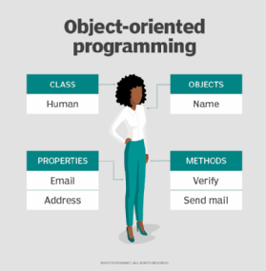
Object Oriented Programming
Object Oriented Programming
There are no sequence of execution
Represent everything as an “object”
Examples
Create a Chef “object”, and ask the Chef to ”cook an egg”
Create a Student “object”, and ask the student to “do the homework”
Create a driver “object”, and ask the driver to “drive me back home”

Slide 13
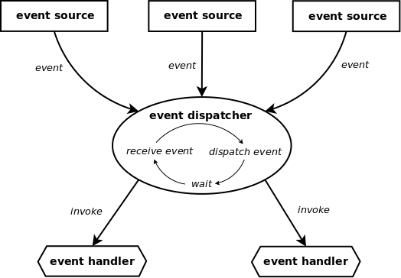
Event-driven Programming
Event Driven Programming
There are no sequence in execution
In general, first in first process
Examples (Smart Home)
When there is sunshine -> Close the curtain
When it is sunset time -> Turn on the lights
When the indoor temperature is more than 28 degrees -> turn on the AC

